Slide 1
Transition to Reception
The Avenue Primary School

Slide 2
Meet the team
Mrs Watson – Head Teacher
Miss Booth – Deputy Head Teacher/ Teacher
Miss Walker – Reception Teacher
Miss Hewitt – Reception Teacher
Mrs Stone – Nursery Nurse
Mrs Walpole -Teaching Assistant
Mrs Zimmerman - 1:1 Teaching Assistant
Mrs Spry – 1:1 Teaching Assistant

Slide 3
Children are assessed against the
7 Areas of Learning

Slide 4
7 Areas of Learning
1. Personal, Social and Emotional Development
Making Relationships
Self-Confidence and Self-Awareness
Managing Feelings and Behaviour

Slide 5
7 Areas of Learning
2. Communication and Language
Listening and Attention
Understanding
Speaking

Slide 6
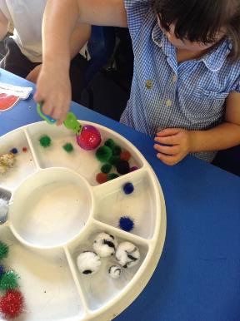
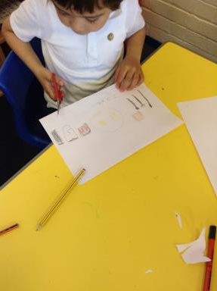
7 Areas of Learning
3. Physical Development
Moving and Handling
Health and Self-Care

Slide 7
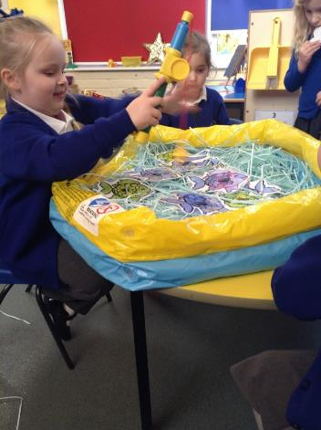
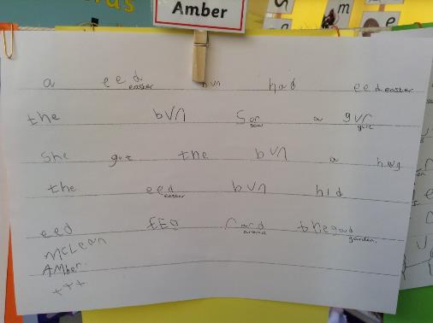
7 Areas of Learning
4. Literacy
Reading
Writing

Slide 8
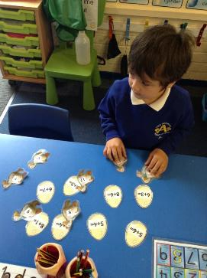
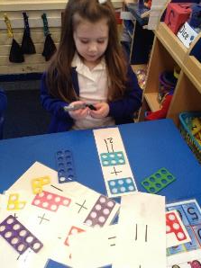
7 Areas of Learning
5. Mathematics
Numbers
Shape, Space and Measure

Slide 9
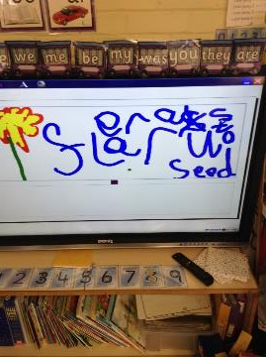
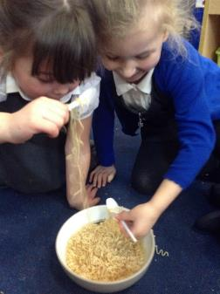
7 Areas of Learning
6. Understanding the World
People and Communities
The World
Technology

Slide 10
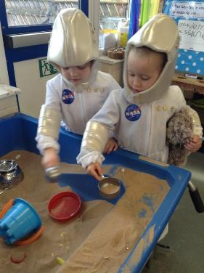
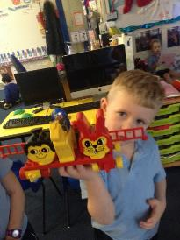
7 Areas of Learning
7. Expressive Arts and Design
Exploring and Using Media
and Materials
Being Imaginative

Slide 11
Characteristics of Learning
Playing and Exploring
Finding out and exploring
Playing with what they know
Being willing to have a go
Active Learning
Being involved and concentrating
Keeping on trying
Enjoying achieving what they set out to do
Creating and Thinking Critically
Having their own ideas
Making Links
Choosing ways to do things

Slide 12
Cornerstones
Curriculum
We cover six topics throughout the year following this scheme. The topics set the theme for the learning and activities in the classroom. The topics are also linked to homework activities, trips and visitors.
Our first topic: ‘Do you want to be friends?’

Slide 13
Stay and Play
Once a term we will invite you into the classroom for ‘Stay and Play’. This will be an opportunity to look at your child's work and spend time completing activities in the classroom together.

Slide 14
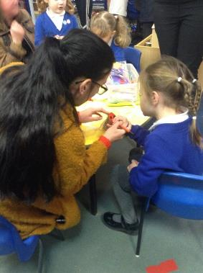
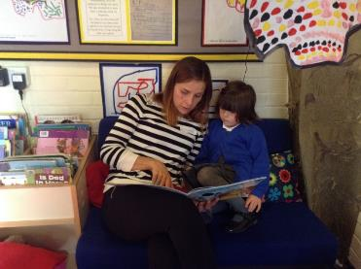
Stay and Play dates
Wednesday 16th October at 1:30
Thursday 2nd April at 1:30
Tuesday 19th May at 1:30

Slide 15
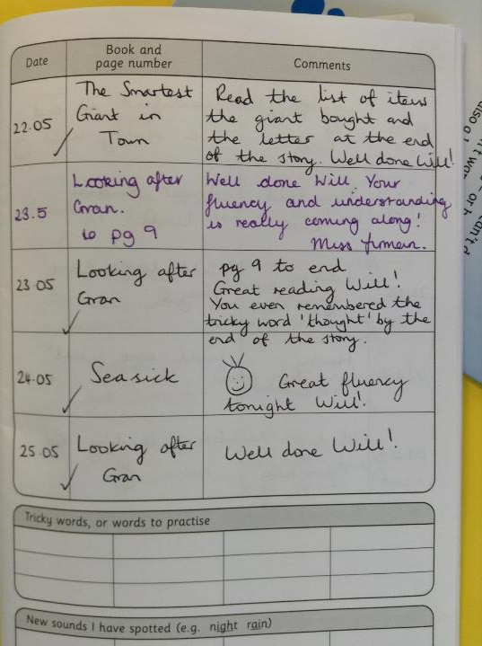
Home Reading
Your child will get a reading book to bring home with a reading log. This book will support your child’s learning in Phonics. The reading book and reading log need to be brought into school every day for reading in the classroom.

Slide 16
Reading sticker chart
Your child will receive a sticker each day they read at home.
Bronze award - 50 reads by Christmas
Silver award - 100 reads by Easter
Gold award - 150 reads by Summer (end of July)
Each time your child achieves an award they choose a book to take home from our fabulous library. However there are strict cut off points at the end of each term to encourage children to achieve 150 reads by summer.
If your child read more than 150 times they also have the opportunity to achieve certificates for up to 400 reads.
*Reading at school does not count, this is an incentive to encourage reading at home.

Slide 17
Sticker Chart
=

Slide 18
Home Reading
From the first week of September your child will bring home books with sentences in for you to read to your child for the first couple of weeks.
Then they will bring home a book without any words in.
Then they will move onto our reading scheme with words which
match their phonetic sounds which they are learning.

Slide 19
Home Reading
Inside your child's reading log please sign and date every time they read at home (even throughout the school holidays) This will ensure we know when a book needs changing and how many stickers to update the chart with. Do not feel you need to comment every time, only if you feel there is something we need to know.
Please be aware that 1 sticker will only be given per day.
To begin with books will be changed on a Monday and a Thursday. This will increase as the year goes on.

Slide 20
Project
Homework
A set of activities based around the current topic. You and your child choose which task to complete each week.
Homework packs to support children's learning. These will include a range of flashcards and other resources. Packs are sent home during some school holidays for you to complete with your child.

Slide 21
Golden Rules
Do look after our property
Do be kind and gentle
Be honest
Do listen to others
Do not speak to people in a disrespectful way
Do work hard

Slide 22
Behaviour Policy
Red card Yellow card
First - verbal warning
Yellow card – following on from a verbal warning
Red card – Stage 1
Stage 2 – time out in parallel Reception class
Stage 3 – Time out in Nursery

Slide 23
Marvellous Me
A fantastic way for us to communicate with you about your child’s learning.
We will update you on ‘new’ learning, send you photos and celebrate your child’s achievements.
We also send reminders e.g. school trip on Tuesday.
Make sure you sign the Marvellous Me permission form and return to the office.

Slide 24
Daily Timetable
8:50 Doors Open
9:00 Register
9:10 Phonics
9:30 Area time
10:20 Literacy
10:40 Playtime
11:00 Maths
11:20 Daily run followed by dough disco / handwriting
11:55 Lunchtime
1:00 Topic focus
1:20 Area time
2:50 Story / singing
3:05-3.15 Doors open
Challenges

Slide 25
School Rewards
House point system – The children receive house points throughout the week for good work, good behaviour, manners etc. They go into a pot and one name is picked out during celebration assembly on a Friday. The lucky child selects a prize!
Reading Challenge – mentioned earlier.
Star of the week – one child from each class will receive this award in the weekly celebration assembly on a Friday. The children can only be eligible for this award if they have read 4x in the week, had full attendance, perfect behaviour and worn the correct school uniform.
Star writer of the week - one child from each class will receive this award in the weekly celebration assembly on a Friday.

Slide 26
How can I prepare my child for Reception?
Develop independence by:
Encouraging your child to get dressed and undressed so that they find changing for P.E. much easier (consider carefully what you dress your child in on P.E days at the start of the year)
Please name everything including shoes. The children are not allowed to wear earrings for P.E.
When you buy your child's new winter coat give them some time to practise taking it on and off and practise fastening it up.
The children have snack daily at playtime (apples, pears, carrots, satsumas, bananas) If your child doesn’t eat fruit think about encouraging this over the summer as they will get peckish throughout the morning!

Slide 27
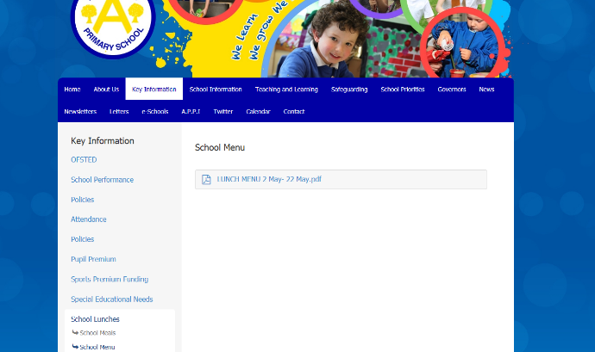
School Lunches
A menu can be found on the school website.
key information tab

Slide 28
Reminders
Please leave your child's P.E. kit on their peg throughout the half-term. We have
a set P.E. day but sometimes things come up and we have to change our P.E.
slot for the week. This will ensure that nobody ever misses out.
The children will continue to have access to the outdoor area. Please ensure they bring a coat and suitable footwear for using it.
As in Nursery we have a contribution tin which will go towards classroom resources.
We have a school twitter feed which we update with photographs and information.
The children are able to bring a water bottle. Water only, no juice. Daily water challenge.
Cloak room independence.
Party list of children's first names. Please let us know if you object to this.
Wow moment templates are in the cloakrooms (to be completed at home)

